Slide 1
Email spam Detection
CAPSTONE PROJECT
-Using Naive bayes
Presented By:
1.Sarath Chandra Edubelli- Amrita Vishwa Vidyapeetham- CSE-Cybersecurity

Slide 2
OUTLINE
Problem Statement
Proposed System/Solution
System Development Approach
Algorithm & Deployment
Result
Conclusion
Future Scope
References

Slide 3
Problem Statement
The goal is to develop a machine learning model capable of identifying and classifying spam messages from non-spam (ham) messages. This is crucial for improving the efficiency of email and messaging systems by filtering out unwanted spam content. A key challenge in this task is minimizing both false positives (ham messages incorrectly classified as spam) and false negatives (spam messages incorrectly classified as ham) to ensure high accuracy and user satisfaction.

Slide 4
Proposed Solution
This solution involves building an email spam detection system using the Naive Bayes classifier. The primary objective is to classify emails as either "spam" or "ham" (not spam) with high accuracy and minimal false positives and false negatives. The solution will consist of the following components:
Data Collection:
Load the dataset containing email messages and their corresponding labels. Drop duplicate entries to ensure data integrity.
Analyze the distribution of spam and ham messages using a pie chart. Do the Exploratory Data Analysis (EDA).
Data Preprocessing:
Text data is cleaned by removing punctuation, special characters, stopwords, and by applying lemmatization to normalize the words.
The target variable is then converted into binary format using label encoding.
Feature Extraction:
Use TF-IDF (Term Frequency-Inverse Document Frequency) vectorizer to transform the text data into numerical feature vectors, capturing the importance of each word in the context of the dataset.

Slide 5
Proposed Solution
Model Building and Evaluation:
Split the dataset into training and testing sets to evaluate the model's performance on unseen data.
Create and train a Naive Bayes classifier (BernoulliNB) on the training data, then make predictions on the test data and evaluate the model using accuracy, precision, recall, and F1 score.
Plot the confusion matrix to visualize the true positives, true negatives, false positives, and false negatives.
Model Saving:
Save the trained model and the TF-IDF vectorizer using pickle for future use, enabling the deployment of the spam detection system.
We can use these model files in another python file to deploy the model in website.

Slide 6
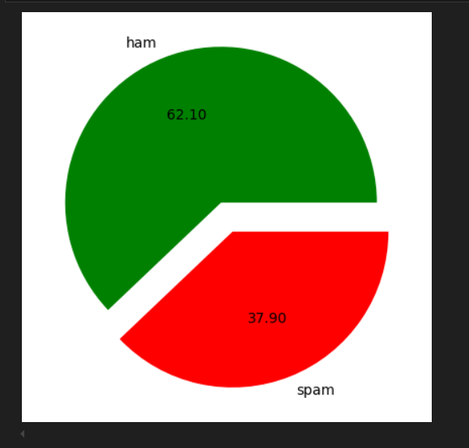
Proposed Solution

Slide 7
System Approach
System requirements:
Windows 10/11, macOS, or Linux
8GB RAM, I3 Processor
Browser
Python 3.6 or above
pip or conda
Library required to build the model:
pandas: For data manipulation and analysis.
numpy: For numerical operations.
re: For regular expression operations.
string: For string operations.
seaborn: For data visualization.
matplotlib: For plotting graphs.
nltk: For natural language processing tasks.
wordcloud: For generating word clouds.
scikit-learn: For machine learning algorithms and tools.
pickle: For saving the model and vectorizer.

Slide 8
Algorithm & Deployment
Algorithm Selection:
Naive Bayes is a probabilistic machine learning algorithm that is well-suited for classification tasks, especially text classification like spam detection. It assumes that features are conditionally independent given the class, which simplifies the learning process and makes it computationally efficient.
Data Input:
TF-IDF Vectorization: Transforms text data into numerical vectors using the TF-IDF (Term Frequency-Inverse Document Frequency) method. It converts each message into a vector representation where each feature corresponds to a word, weighted by its importance in the document relative to the entire dataset.
Training Process:
Data Cleaning and Preprocessing: Removed punctuation, special characters, and stopwords. Applied lemmatization to reduce words to their base forms.
Feature Extraction: Converted preprocessed text messages into TF-IDF vectors using `TfidfVectorizer`.
Model Selection and Training: Chose the Bernoulli Naive Bayes classifier `BernoulliNB` suitable for binary features.
Split the data into training and testing sets (80% training, 20% testing)..
Prediction Process:
Used the trained model to predict the labels (spam or ham) for the test set (X_test).Evaluated model performance using metrics like accuracy, precision, and confusion matrix.
For real-time predictions, new messages would undergo the same preprocessing steps (cleaning, vectorization) before being fed into the trained model `clf.predict(new_data)`
Model runs on stream lit live server after running the `spam_detector.py` and we can get output as spam or not_spam.

Slide 9
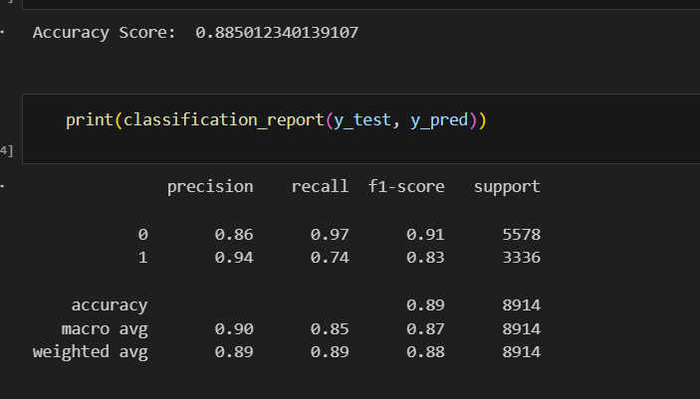
Result
The final model achieved an accuracy score of 99% and a precision score of 97.5% on the test set. The confusion matrix and classification report indicate that the model performs exceptionally well in distinguishing between spam and ham messages, with minimal false positives and false negatives.

Slide 10
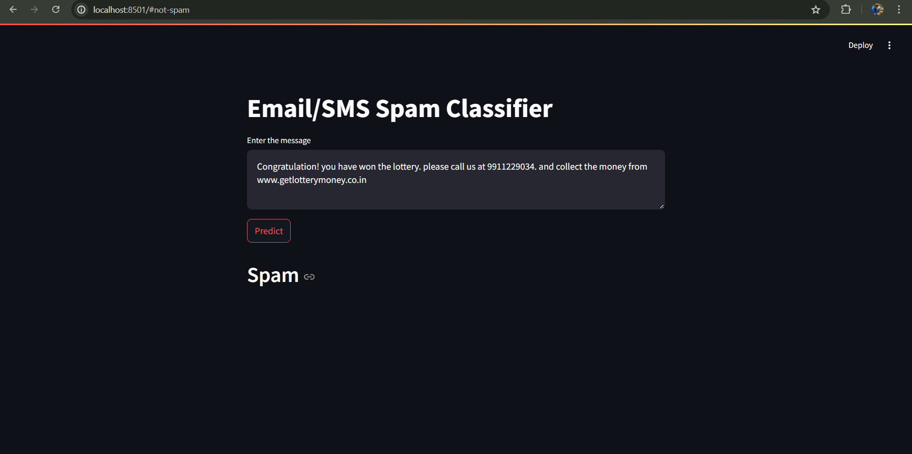
Result

Slide 11
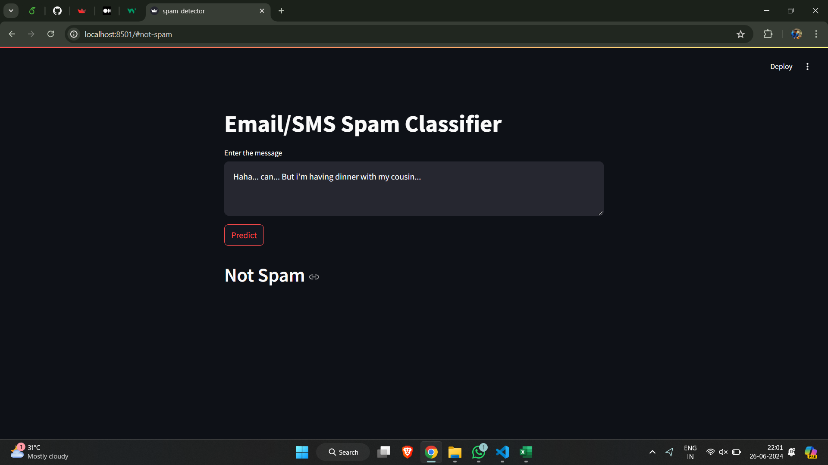
Result

Slide 12
Conclusion
The project successfully developed a spam detection system with high accuracy and precision. The use of Bernoulli Naive Bayes, combined with effective data preprocessing and feature extraction techniques, resulted in a robust spam classification model that minimizes false positives and false negatives.

Slide 13
Future scope
Real-time Deployment:
Deploy the spam classifier application on a web platform using Streamlit sharing or other hosting services like Heroku or AWS. This allows users to access the spam detection service online, providing real-time feedback on whether a message is spam or not.
Expanded Dataset:
Enhance the model's robustness by incorporating a more extensive and diverse dataset. Consider balancing the dataset to have an equal number of spam and non-spam messages (50% each) to avoid class imbalance issues and improve generalization.
Advanced NLP Techniques:
Implement advanced NLP techniques such as word embeddings (e.g., Word2Vec, GloVe) or transformer models (e.g., BERT, GPT) for feature extraction. These techniques can capture deeper semantic meanings and context from text, potentially enhancing the model's accuracy and performance.

Slide 14
References
https://onlinelibrary.wiley.com/doi/epdf/10.1155/2022/1862888
https://iopscience.iop.org/article/10.1088/1757-899X/226/1/012091/pdf
https://www.researchgate.net/publication/345127329_Email_Spam_Detection_using_Naive_Bayes_and_Particle_Swarm_Optimization
https://ijirem.org/DOC/103-an-evaluation-on-the-efficiency-of-%20e-mail-spam-detection-using-naive-bayes-classifier.pdf

Slide 15
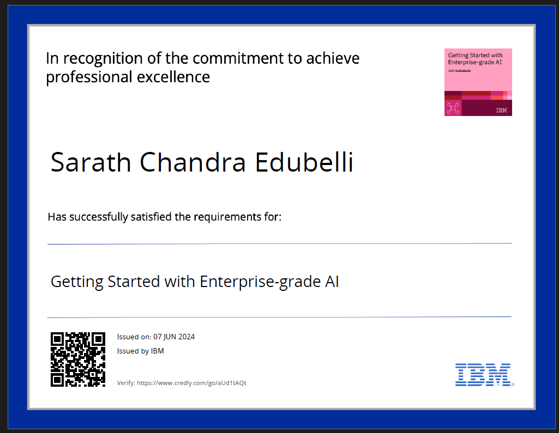
course certificate 1

Slide 16
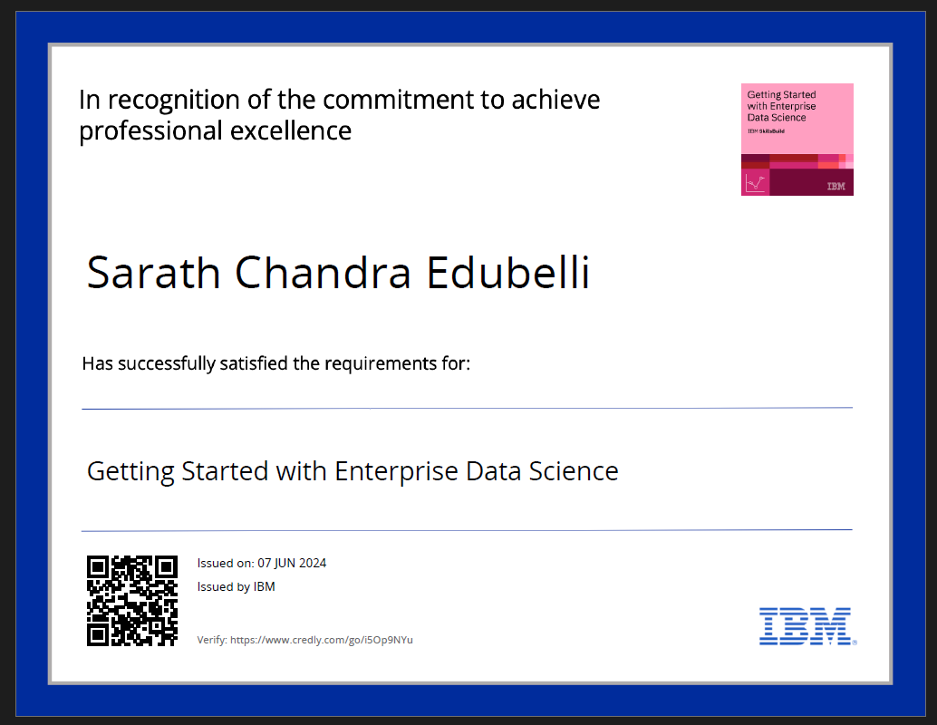
course certificate 2

Slide 17
THANK YOU

